Slide 1

chatfau system presentation
By the binary bros
Jordan small – z23465928
Alirio da rocha – z23335350
Nico arcelin – z23299045
Notes:
Hello all, showcased today by the Binary bros will be a complete System Presentation for ChatFAU

Slide 2
Software requirements specifications (SRS)
Presented by
Jordan small

Slide 3
Introduction to chatfau
purpose
scope
ChatFAU is a web-based chat application designed to facilitate academic discussions and communication between students and educators at Florida Atlantic University (FAU).
Users can create accounts, join academic groups, and engage in discussions. Features include real-time chat, user profiles, moderation, and academic community creation.

Slide 4
Product overview
Target users: Students, educators, and faculty
Key Features:
Academic-focused chat rooms and private messaging
Role-based access (admin, teacher, moderator, student)
Profile customization and achievement badges
Polls and quizzes within study groups
Goal: Create a productive, collaborative platform for academic communication
Notes:
The target users for ChatFAU include students, educators, and faculty at FAU. As the product expands, a focus will be made for implementation of other academic institutions.
Key Features include:
The goal of the application is to bridge the gap between students and educators and…

Slide 5
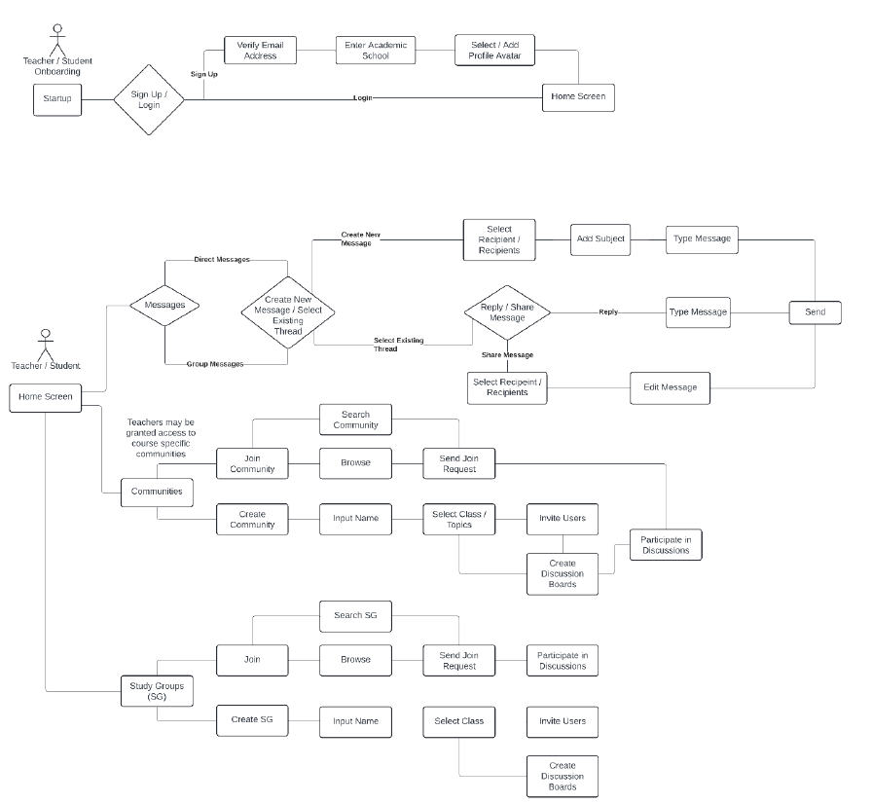
Core functionalities
User Onboarding: Sign up via school email (SSO), with teacher verification
Messaging: Direct, group, and private messages with attachments and emoji support
Communities and Study Groups: Users join or create groups for academic discussions
Moderation Tools: Mute, ban, and silence functionalities for community leaders
Notes:
To the right is a use case diagram taken from the product’s SRS document, but some of the core functionalities of the application include:

Slide 6
User roles & permissions
Permissions will be managed using Supabase with Role-Based Access Control (RBAC)
Administrators: Full access to all communities and data
Teachers: Can create and manage communities for all courses
Moderators: Enforce rules in chatrooms and groups
Students: Participate in discussions but cannot create groups

Slide 7
Additional System Features
Polls & Quizzes: Teachers and moderators can post polls and quizzes; users can participate in them and gain badges
Messaging: Support for emojis, attachments, and formatted text
Study Group Functions: Temporary, course-specific groups for collaboration during class duration
Notifications: Customizable notification preferences (email or in-app)

Slide 8
External interfaces
User Interface (UI): Intuitive, modern design, compatible with various devices (PC, mobile, tablet)
Hardware Interfaces: Cloud-based server management for data storage and chat services
Software Interfaces:
Supabase for database management
WebSockets for real-time messaging
TLS encryption for secure data transmission
Single Sign-On (SSO): FAU’s SSO will handle secure user authentication

Slide 9
Non-functional requirements
Reliability: Backup servers and disaster recovery
Availability: Accessible from any device with internet access; responsive UI for different screen sizes
Security: Data encryption and hashed sensitive information. Utilizes FAU’s Single Sign-On (SSO) for authentication
Maintainability: Code documented and versioned via GitHub. Regular archiving of unused data
Notes:
In order to maintain system health and longevity, there needs to be an emphasis on non-functional requirements.
A reliable system will call for Backup maintenance and disaster recovery protocolsl.
Continued availability will require universal device accessibility with a responsive UI.
To provide optimal security, data will be encrypted, sensitive information will be hashed, and sign-ins will be authenticated.
Throughout the way, the product will be well maintained through documented code with version control and regular archiving of unused data

Slide 10
Legal & compliance
Privacy & Data Protection: Adheres to FERPA regulations to ensure student privacy
Security Measures: Sensitive data, including passwords and private messages, is encrypted and hashed
Terms of Use & Privacy Policy: Clear documentation for users regarding data usage and privacy
Notes:
The product will be fully compliant to legal regulations. As mentioned, there will be a number of security measures in place. This ensures student privacy and data protection, with adherance to FERPA regulations. Clear doc… will be outlined in tos/pp

Slide 11
Software design document (SDD)
Presented by
Alirio da rocha

Slide 12
System architecture
User Management Module: Handles registration, authentication, and profile management.
Messaging Module: Manages real-time chat and private messaging.
Group Management Module: Supports study groups and communities.
API Layer: Interfaces for frontend communication and backend operations.
Database: Secure storage with Supabase using Row Level Security.

Slide 13
Security and Safety
Measures Implemented:
Data encryption (AES-256 for storage, TLS/SSL for transit).
Password hashing with strong algorithms.
Multi-factor authentication (MFA).
Database access controls and monitoring.
Penetration Testing:
Ensures resistance to real-world attack scenarios.

Slide 14
Design Decisions
Functional Decisions:
Real-time messaging with WebSockets for minimal latency.
Modular design for scalability and easy updates.
Non-functional Decisions:
Use of Supabase for efficient database management.
Integration of SSO for user convenience and security.

Slide 15
Key Features
User Experience:
Intuitive UI inspired by popular chat applications.
Notifications and customizable settings for user convenience.
Future Expansion:
Potential to include other educational institutions beyond FAU.

Slide 16
Challenges and Constraints
Challenges:
Balancing simplicity with advanced features.
Ensuring scalability for increasing user loads.
Constraints:
Dependence on third-party services like Supabase and SSO providers.
Managing performance overhead due to modular architecture.

Slide 17
Conclusion SDD
ChatFAU is designed to enhance academic collaboration with a robust, secure, and scalable system.
The SDD ensures a structured path for implementation and future expansion.
ChatFAU is not just a communication tool; it's a step forward in transforming academic collaboration

Slide 18

Software test document (STD)
Presented by
Nico arcelin
Notes:
A Software Test Documentation (STD) serves as a blueprint for the entire testing process. It includes; Test Plans, Test Cases, Test Environment, and Testing Approach. This ensures all aspects of software quality are addressed.
Having well defined Software Test Documentation is critical because it create a structured approach to testing which identifies issues earlier and create alignment between all stakeholders.

Slide 19
Goals of software testing
Ensure functionality aligns with requirements
Validate performance under expected and extreme conditions.
Verify compatibility across devices, platforms, or browsers
Guarantee security and user data protection
Give real world examples. MICROSOFT CRASH
Notes:
Mail goal is to define the scope, objectives, strategies, and approach for testing the ChatFAU platform.

Slide 20
Key sections in the std
Test Items
User Management Module
Messaging Module
Study Group Management Module
Moderation Tools
Database Layer
API Layer
Frontend (Client)
Test Features
Use Authentication and Role Management
Real-Time Messaging
Study Group Management
Moderation Features
Data Protection and Security
Scalability and Performance

Slide 21
Tools and technologies
Environment
Test Tools Config
Hardware
Staging Server Configurations
Network Simulation Tools
WANem or Clumsy
Preloaded Test Data (Consistency)
Automated Testing Frameworks like Jest, Selenium or Mocha.
API Testing Tools (Postman)
Performance Testing Tools
Security Testing Tools
Logging and Monitoring
Hardware: 8-core CPU, 16 GB RAM SSD
Windows, MacOS, IOS, and Android devices

Slide 22
Case study
Test Case ID: TC-UM-001
Verify user registration with valid details
Precondition: User is not registered
Steps
Navigate to registration page
Enter valid user details
Click “Register”
Expected: User is successfully registered and activation email is sent

Slide 23
Results and benefits
Successes
Messaging functionality worked flawlessly across devices.
Teachers were able to create and manage group chats effectively
Admin controls performed well
Issues Identified:
Delayed push notification for students using mobile data or under restricted networks
DUO MOBILE push notification issues
Restricted network access issues (FAU Firewall)

Slide 24
conclusion and recommendations
Final System Assessment:
Functional stability and usability are aligned with requirements
Core features are effective
Recommendations:
Improve file sharing
Reach out to DUO MOBILE and address speed issues
Scaling tests

